Slide 1
Lecture 8: Mathematical Functions, Characters
Reading: Chapter 4, 4.1 - 4.3

Slide 2


The Math Class
Java provides many useful methods in the Math class for performing common mathematical functions.
There are also several very useful constants available in the Math class.

Slide 3
Constants from the Math class
Two constants: One for the value of pi and the other for the value of e (the base of the natural logarithm).
Both are doubles.
No parentheses come after the constants.
Math.PI
Math.E
3.14159265358979323846
2.718281828459045

Slide 4
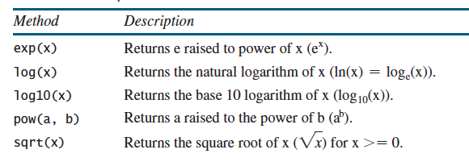
Exponent Methods
Math.exp(1)
Math.sqrt(4)
Math.pow(2, 3)
e¹
√4
2³
returns 2.71828
returns 2.0
returns 8.0

Slide 5
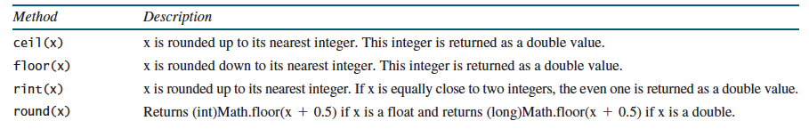
Rounding Methods
Math.ceil(2.8)
Math.floor(2.1)
Math.rint(2.9)
Math.round(2.6)
returns 3.0
returns 2.0
returns 3.0
returns 3
Math.ceil(2.1)
Math.floor(2.8)
Math.rint(2.1)
Math.round(2.1)
returns 3.0
returns 2.0
returns 2.0
returns 2

Slide 6
min, max and abs Methods
Math.min(2, 5)
Math.max(2, 5)
Math.abs(-4)
Finds the minimum of two numbers
Finds the maximum of two numbers
Finds the absolute value of a number
returns 2
returns 5
returns 4
Math.min(2.1, 1.9)
Math.max(2.1, 1.9)
Math.abs(-4.3)
Finds the minimum of two numbers
Finds the maximum of two numbers
Finds the absolute value of a number
returns 1.9
returns 2.1
returns 4.3

Slide 7
Example
Write a program that asks the user to enter two points and then computes the distance between them.
distance =
Enter x1: 1
Enter y1: 2
Enter x2: 4
Enter y2: 6
The distance is 5.0.
We are going to have to use two methods from the Math class. What are they?
sqrt and pow

Slide 8
import java.util.Scanner;
public class Distance
{
public static void main(String[] args)
{
Scanner keyboard = new Scanner(System.in);
double x1, y1, x2, y2;
S.O.P(“Enter x1: ”);
x1 = keyboard.nextDouble();
S.O.P(“Enter x2: ”);
x2 = keyboard.nextDouble();
S.O.P(“Enter x1: ”);
y1 = keyboard.nextDouble();
S.O.P(“Enter x2: ”);
y2 = keyboard.nextDouble();
double diffx = x2 - x1;
double diffy = y2 - y1;
double inside = Math.pow(diffx, 2) + Math.pow(diffy, 2);
double distance = Math.sqrt(inside);
S.O.P.L(“The distance is ” + distance + “.”);
}
}

Slide 9
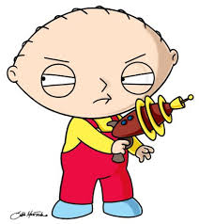
Character Data Type
A character data type represents a single character.
Computers use binary numbers (0’s and 1’s) to store character data types.
Mapping a character to its binary representation is called encoding.
Java uses Unicode, an encoding scheme.
Unicode was originally designed as a 16-bit character encoding. However, it turned out that the 65,536 characters possible using 16-bit encoding was not sufficient.
It’s been extended to allow up to 1,112,064 characters.
The characters that go beyond the original 16-bit limit are called supplementary characters.

Slide 10
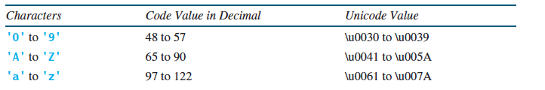
Character Data Type
A 16-bit Unicode character takes two bytes.
Preceded by \u and followed by 4 hexadecimal digits that run from \u0000 to \uFFFF
char is the data type
char letter = ‘A’;
char letter = ‘\u0041’;
Assigns the letter A to the variable letter using Unicode

Slide 11
Comparing Characters
Two characters can be compared using the relational operators just like comparing two numbers.
When you compare two characters, the Unicode values are compared.
The order is 0 - 9, A - Z, a - z
What about the number 10? That’s not a single character!
S.O.P.L(‘a’ < ‘b’);
S.O.P.L(‘a’ < ‘A’);
S.O.P.L(‘1’ < ‘8’);
True. Unicode for ‘a’ (97) is less than Unicode for ‘b’ (98)
False. Unicode for ‘a’ (97) is greater than Unicode for ‘A’ (65)
True. Unicode for ‘1’ (49) is less than Unicode for ‘8’ (56)

Slide 12


Why compare characters?
Assume that the variable letter has been declared and has a value assigned to it.
if (letter >= ‘A’ && letter <= ‘Z’)
S.O.P.L(letter + “ is uppercase.”);
if (letter >= ‘a’ && letter <= ‘z’)
S.O.P.L(letter + “ is lowercase.”);
if (letter >= ‘0’ && letter <= ‘9’)
S.O.P.L(letter + “ is numeric.”);

Slide 13
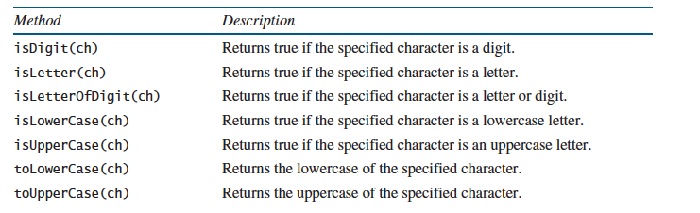
The Character Class
S.O.P.L(“Character 6 is a digit: ” + Character.isDigit(‘6’));
S.O.P.L(“Character a is lower case: ” + Character.isLowerCase(‘a’));
S.O.P.L(“Character A is upper case: ” + Character.isUpperCase(‘A’));

Slide 14

char letter = ‘a’;
char upper = Character.toUpperCase(letter);
S.O.P.L(“The letter ” + letter + “ capitalized is “ + upper);
Output Window
The letter a capitalized is A

Slide 15

Escape Sequences for Special Characters
What if you wanted to print out the following statement:
He said “Good morning!”
S.O.P.L(“He said “Good morning!””);
Compile error!
The compiler thinks the second quotation character is the end of the string.
It does not know what to do with the rest of the characters.
You have to “escape” certain special characters when printing.

Slide 16
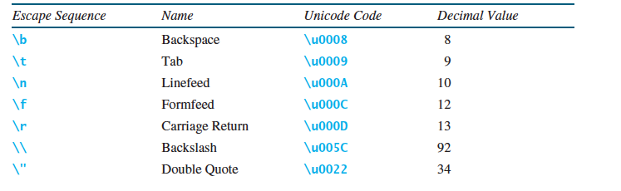
S.O.P.L(“He said “Good morning!””);
Wrong!
S.O.P.L(“He said \“Good morning!\””);
Right!

Slide 17

What if...
S.O.P.L(‘a’);
S.O.P.L(‘b’);
S.O.P.L(‘a’ + ‘b’);
Output Window
a
b
195
When you use the + operator with character data types it returns the decimal code (which it gets from the hexadecimal code) and adds them together.

Slide 18

No, you do not have to memorize all the decimal values for the characters!!

Slide 19
Quiz #1 Review
public class Quiz1a
{
public static void main(String[] args)
{
int a, b;
a = -5;
b = 2;
int div = a / 2;
System.out.println("div is: " + div);
a *= div;
b++;
System.out.println("a is: " + a);
System.out.println("b is: " + b);
double c = a % b;
System.out.println("c is: " + c);
double num = 3.0;
int val = 2;
System.out.println(num / val);
}
}
Output Window
div is: -2
a is: 10
b is: 3
c is: 1.0
1.5
Memory
a:
b:
div:
c:
num:
val:
\
-5
10
\
2
3
-2
1.0
3.0
2

Slide 20
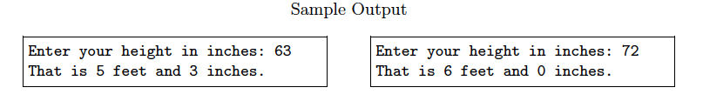
Quiz #1 Review
Write a program that asks the user to enter their height in inches. The program should then convert the inches to feet and print out the number of feet and the remaining inches (Note: 1 foot = 12 inches). The program structure has been created for you. Two sample runs have been provided.

Slide 21
import java.util.Scanner;
public class HeightInInches
{
public static void main(String[] args)
{
Scanner keyboard = new Scanner(System.in);
int height;
S.O.P("Enter your height in inches: ");
height = keyboard.nextInt();
int feet = height/12;
int remaining = height % 12;
S.O.P.L("That is " + feet + " feet and " + remaining + " inches.");
}
}

Slide 22
The quizzes and their solutions are posted online. Practice with them!

Slide 23

That’s all for today folks!
Read Chapter 4, Sections 4.1 - 4.3

